Slide 1
Teradata Training
13-- 12/04/2018

Slide 2
Topics
Secondary Index
Unique Secondary Index (USI)
Non-Unique Secondary Index (NUSI)
Statistics --MVC
Explain
Hashing Algorithm

Slide 3
Secondary Index - Types
Tables | Syntax
Unique Secondary Index | CREATE UNIQUE INDEX(Netpay) on testdb1.empSalary; DROP UNIQUE INDEX(Netpay) on testdb1.empSalary;
Non-Unique Secondary Index | CREATE INDEX(FirstName) on testdb1.Employee; DROP INDEX(Firstname) on testdb1.Employee;

Slide 4
Statistics
Statistics | Syntax
COLLECT Statistics | COLLECT STATISTICS COLUMN(EmployeeNo) ON Employee;
Viewing Statistics | HELP STATISTICS employee;

Slide 5
MVC
Compression | Definition | Syntax
Multi-Value Compression | Compression is used to reduce the storage used by the tables | CREATE SET TABLE employee ( EmployeeNo integer, FirstName CHAR(30), LastName CHAR(30), BirthDate DATE FORMAT 'YYYY-MM-DD-', JoinedDate DATE FORMAT 'YYYY-MM-DD-', employee_gender CHAR(1), DepartmentNo CHAR(02) COMPRESS(1,2,3) ) UNIQUE PRIMARY INDEX(EmployeeNo);
LIMITATIONS | Only 255 values can be compressed per column. Primary Index column cannot be compressed. Volatile tables cannot be compressed.

Slide 6
EXPLAIN
Explain | Definition | Syntax
Explain | EXPLAIN command returns the execution plan of parsing engine in English. | EXPLAIN SELECT * FROM employee;

Slide 7
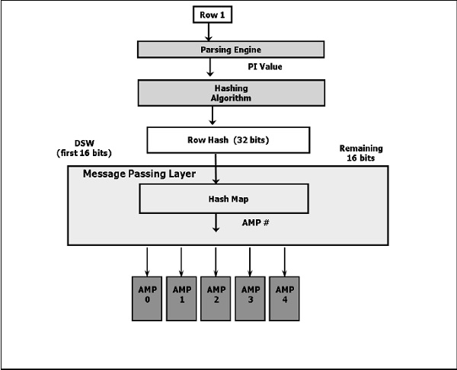
Hashing Algorithm

Slide 8
Hashing Algorithm
A row is assigned to a particular AMP based on the primary index value. Teradata uses hashing algorithm to determine which AMP gets the row.
How Tables are Stored: Tables are sorted by their Row ID (Row hash + uniqueness id) and then stored within the AMPs. Row ID is stored with each data row.

Slide 9
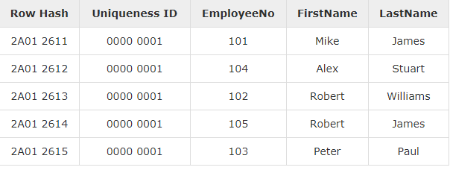
How Tables are Stored

